Slide 1



MIT805-Semester Exam
View in Power BI
Last data refresh:
11/24/2021 7:45:47 AM UTC
Downloaded at:
11/24/2021 8:05:37 AM UTC

Slide 2
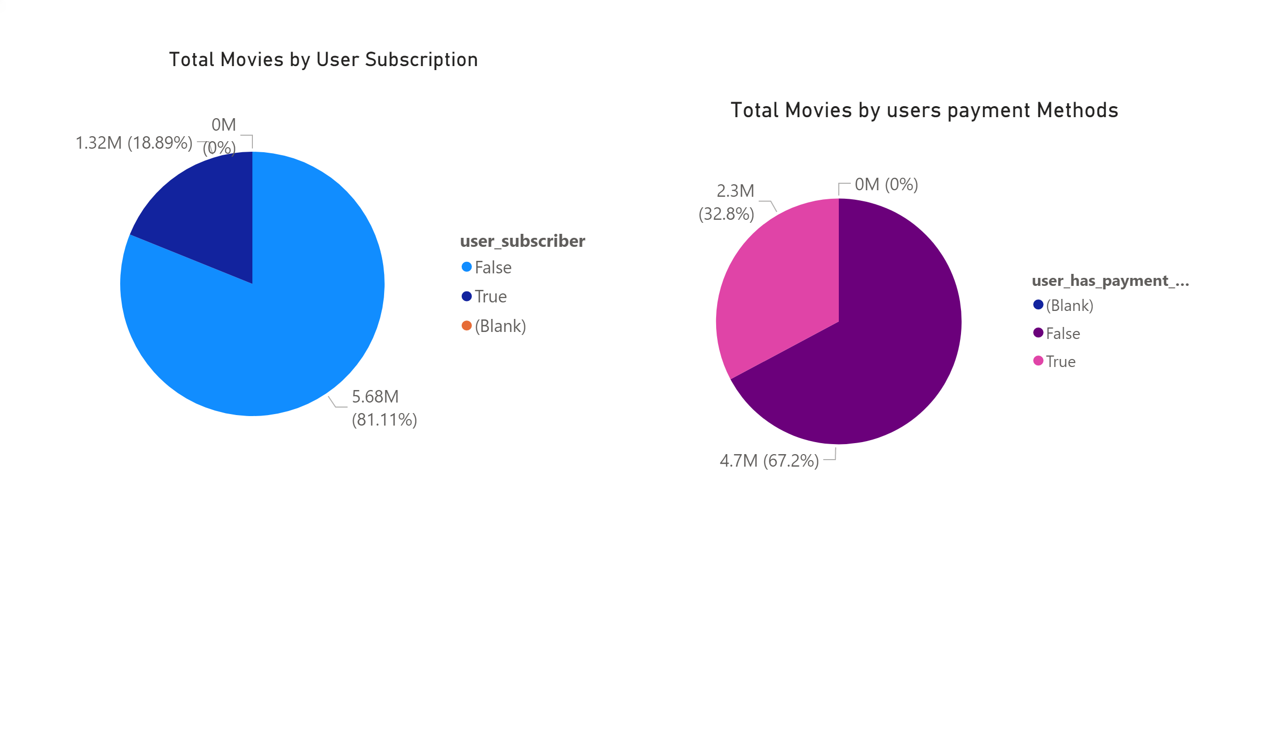
Page 1
Notes:
Total Movies by User Subscription
No alt text provided.
Total Movies by users payment Methods
No alt text provided.

Slide 3
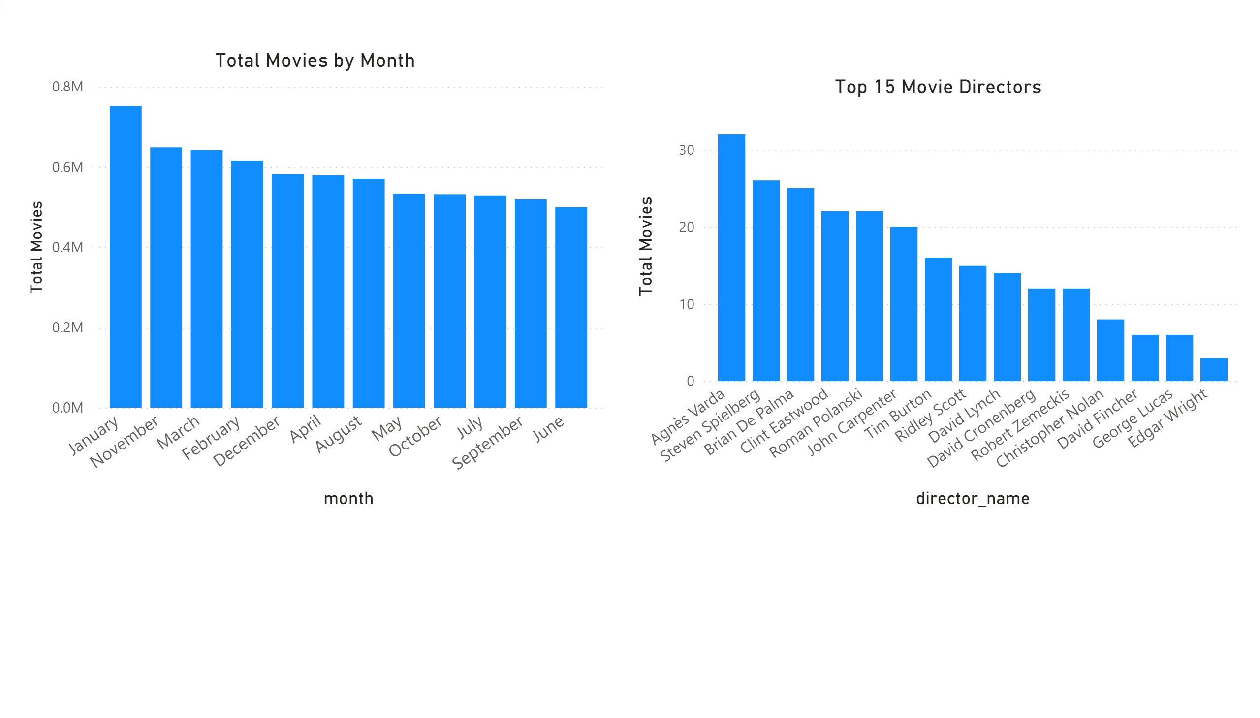
Page 2
Notes:
Total Movies by Month
No alt text provided.
Top 15 Movie Directors
No alt text provided.

Slide 4
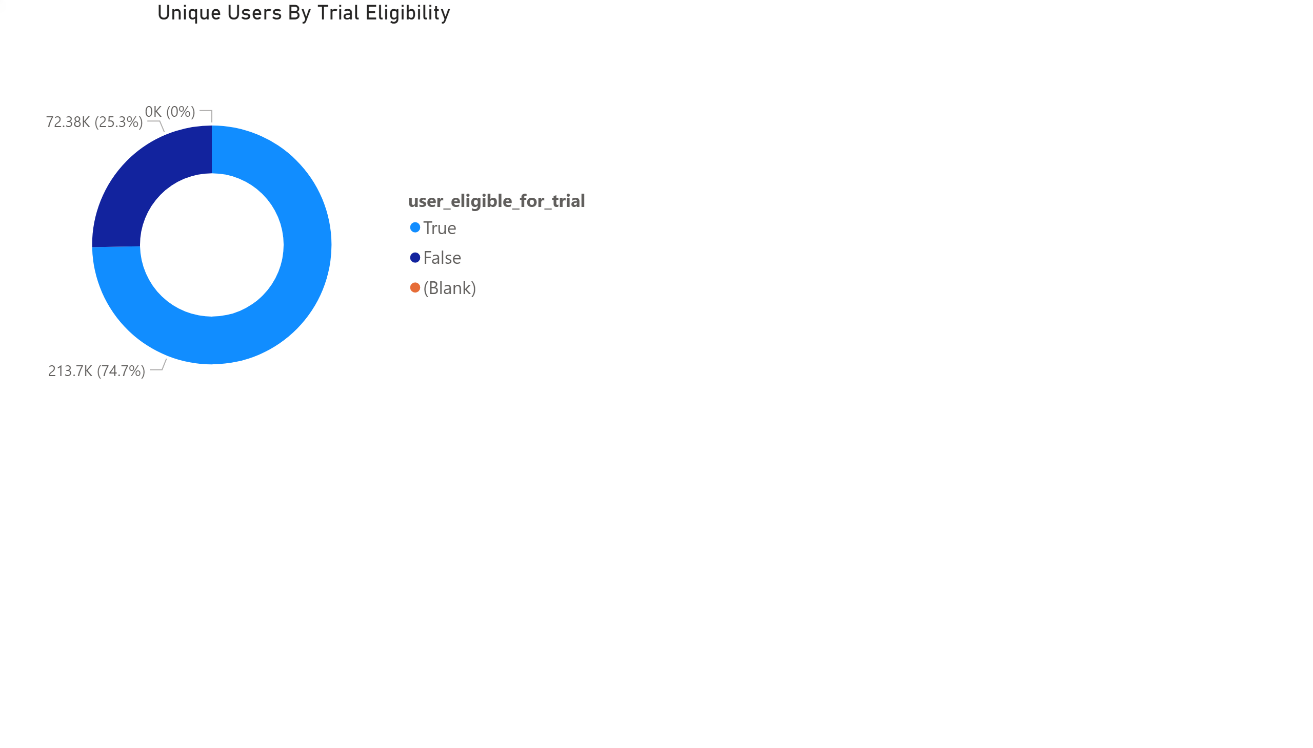
Page 3
Notes:
Unique Users By Trial Eligibility
No alt text provided.

Slide 5
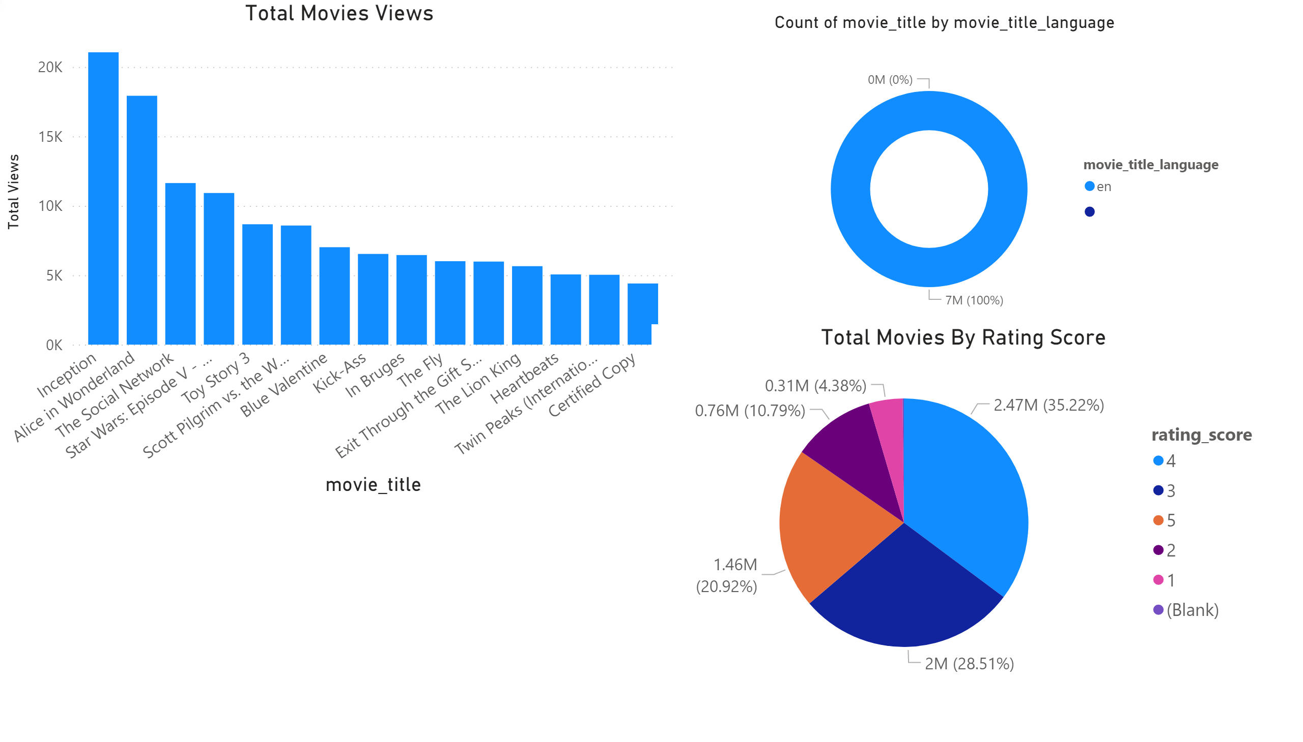
Page 4
Notes:
Total Movies Views
No alt text provided.
donutChart
No alt text provided.
Total Movies By Rating Score
No alt text provided.

Slide 6
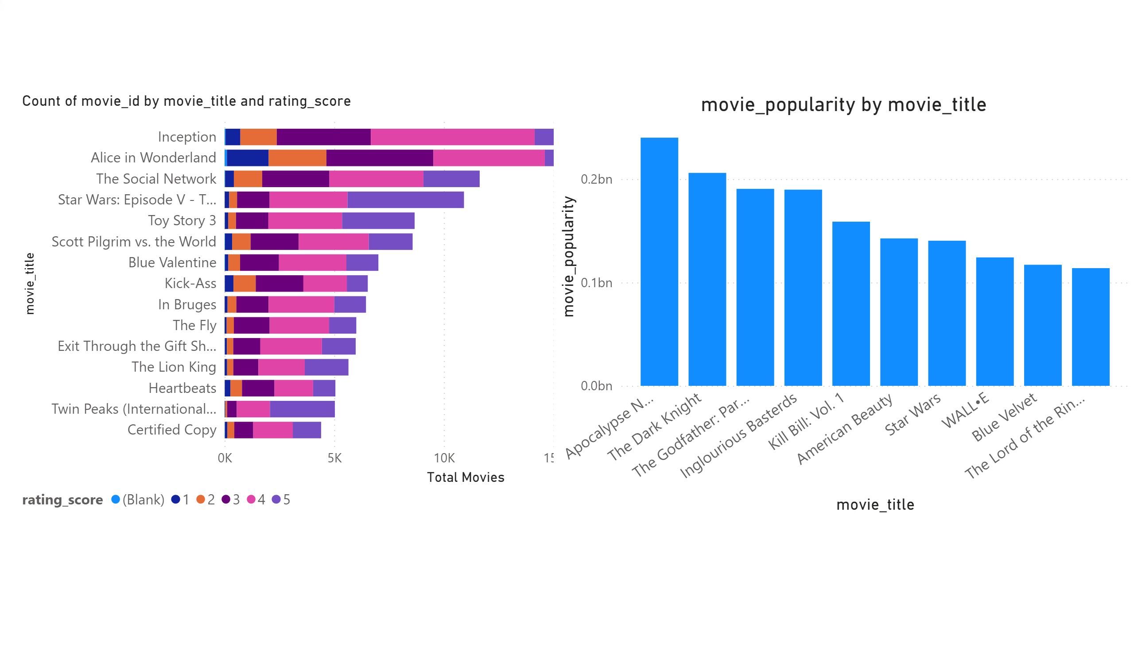
Page 5
Notes:
barChart
No alt text provided.
clusteredColumnChart
No alt text provided.

